Slide 1


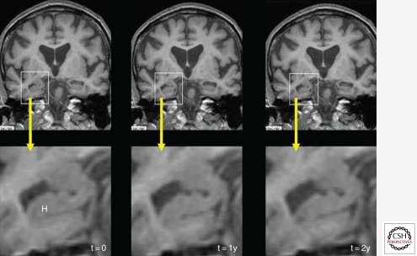
Latent Space Exploration of Generative Adversarial Networks on Alzheimer’s Disease MRI Scans
David Lee
Boston University
Outline
Acknowledgements
This project explores the ways in which Generative Adversarial Networks can be employed to aid in MRI analysis of Alzheimer’s Disease patients and at-risk individuals.
I would like to thank my mentor Dr. Arash Yazdanbakhsh and my fellow researchers at his Computational Neuroscience and Vision Lab for their support. I also acknowledge my data is sourced from the ADNI and OASIS3 datasets.
Research Questions
Hippocampal deterioration (temporal horn of lateral ventricle) (https://www.ncbi.nlm.nih.gov/pmc/articles/PMC3312396/). Can Generative Adversarial Networks recreate common features of progression such as hippocampal deterioration in an MRI scan?
Hypothesis
What applications do Generative Adversarial Networks (GANs) have in analyzing medical MRI scans such as for Alzheimer’s Disease?
Are GANs capable of accurately reproducing both individual stages of AD as well as progression between stages of AD?
The latent space of a Generative Adversarial Network is capable of holding not just individual representations of an Alzheimer’s Disease MRI scan, but also disease progression of AD such that there exists a way to reliably transform points in the latent space between different stages of AD severity.

Slide 2
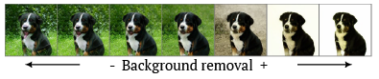
Latent Space Exploration of Generative Adversarial Networks on Alzheimer’s Disease MRI Scans
David Lee
Boston University
Abstract
Early detection of Alzheimer’s Disease (AD) benefits at-risk individuals medically, socially and financially by alleviating more intensive and less successful care options down the road. Generative adversarial networks (GANs) can synthesize realistic prodromal AD MRI scans which help professionals screen for the disease.
StyleGAN2, a state-of-the-art GAN, was trained on AD MRI coronal slices featuring the hippocampus, which deteriorates as AD worsens. The GAN’s generator was used to encode newly introduced MRI scans into latent vectors. Principal component analysis was then performed on the sample domain of latent vectors.
The latent space did not contain any evidence to suggest that the network had ‘learned’ AD progression. However, the GAN was able to replicate newly introduced images very well, with a structural similarity index measure of 0.938 ± 0.001.
The evidence suggests that GANs are capable of generating synthetic AD MRI scans for purposes such as supplementing existing data for an image classification task, but do not necessarily ‘understand’ AD progression in an MRI scan.
GANs have proven to be robust in understanding relationships between images in order to allow efficient interpolation and extrapolation between different attributes. Are these abilities useful in analyzing MRI scans?

Slide 3
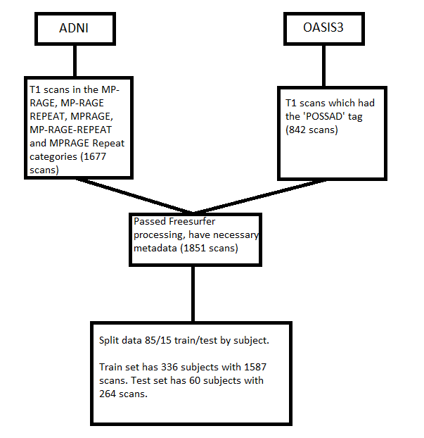
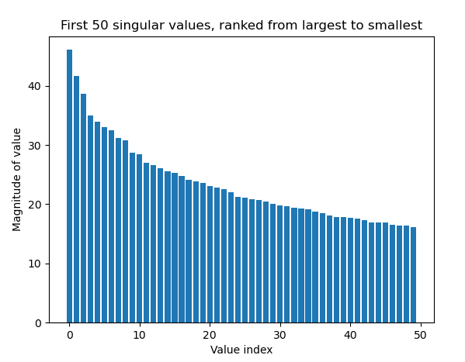
Latent Space Exploration of Generative Adversarial Networks on Alzheimer’s Disease MRI Scans
David Lee
Boston University
Materials and Methods
StyleGAN2 was picked as the GAN of choice due to abundant online documentation. Since it operates in 2-D and MRI scans are in 3-D, the MRI scans were aligned to a template in Freesurfer and 2-D coronal slices containing the hippocampus were extracted.
Principal Component Analysis was run on GAN latent vector representations of images in the testing set. The first three singular values were used for further analysis.
Data split diagram.
Pivotal tuning before and after

Slide 4
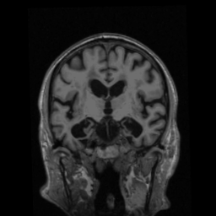
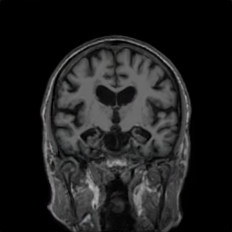
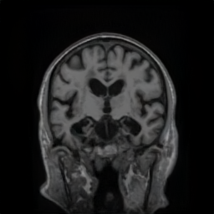
Latent Space Exploration of Generative Adversarial Networks on Alzheimer’s Disease MRI Scans
David Lee
Boston University
Materials and Methods
Pivotal tuning improved the GAN’s ability to reproduce images. Compared to the original image (far left), the reproduction without pivotal tuning (center) achieved a SSIM of 0.58 and a RMSE of 32.06, but the reproduction with pivotal tuning had a greater SSIM of 0.91 and a lower RMSE of 9.21
Pivotal tuning before and after

Slide 5
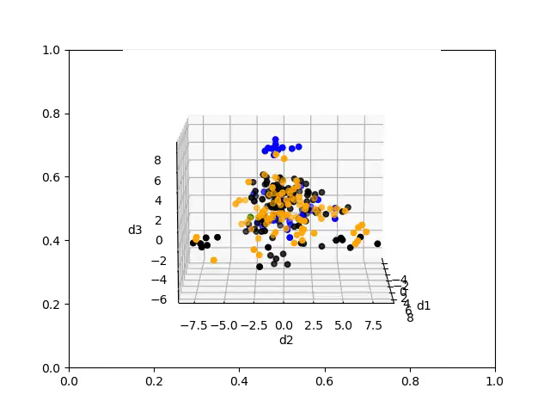
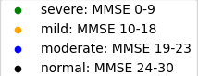
Latent Space Exploration of Generative Adversarial Networks on Alzheimer’s Disease MRI Scans
David Lee
Boston University
Latent representations of the training set of scans were pulled from the GAN. These vectors were dimensionally reduced via PCA and the first three dimensions were plotted. The points were color-coded by the MMSE score matched with the image. There is a lack of distinct regions.

Slide 6
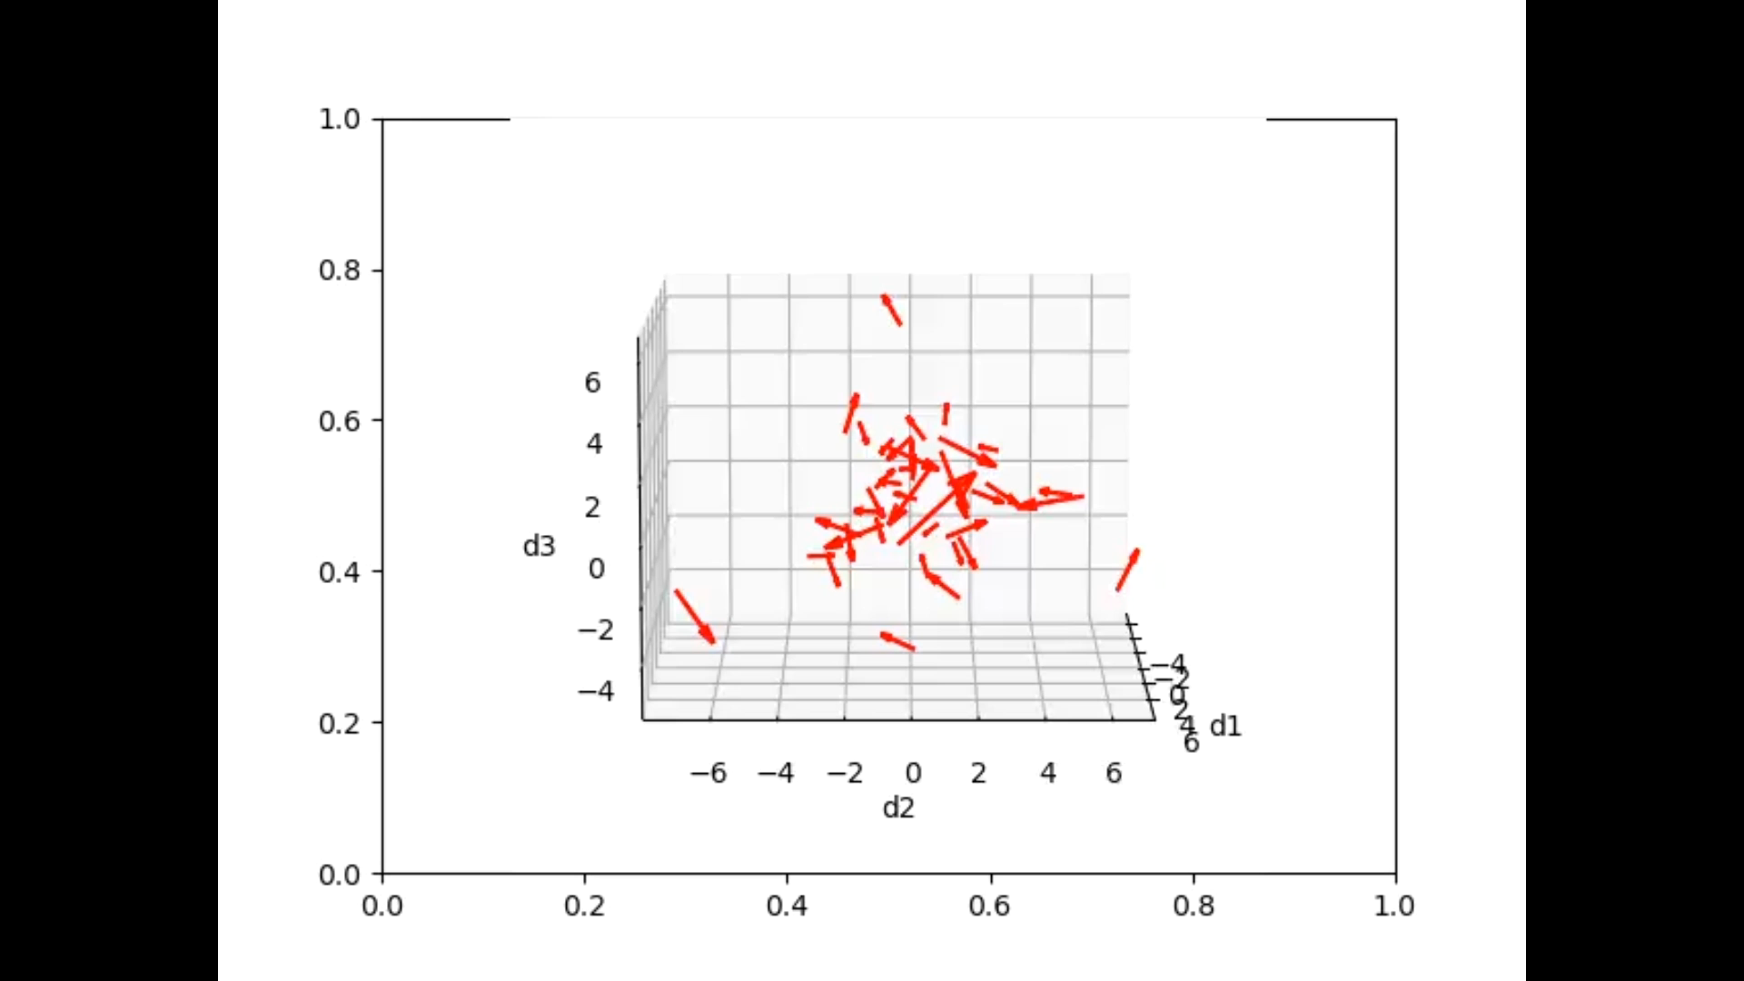
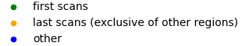
Latent Space Exploration of Generative Adversarial Networks on Alzheimer’s Disease MRI Scans
David Lee
Boston University
For each subject represented in the testing set, a vector was drawn from the average of the subject’s first scans to the average of the subject’s last scans. The ‘time progression’ vectors were all plotted together. No consistent directions of change appear.

Slide 7
Latent Space Exploration of Generative Adversarial Networks on Alzheimer’s Disease MRI Scans
David Lee
Boston University
Results and Conclusion
GANs can generate individual stages of AD accurately, with a structural similarity index measure of 0.938 ± 0.001.
However, no evidence suggests that GANs understand the overall progression of AD from scan to scan.
Current tradeoff between performance and image quality, as well as lack of high-resolution MRI scans, are barriers to using GANs.

Slide 8
Latent Space Exploration of Generative Adversarial Networks on Alzheimer’s Disease MRI Scans
David Lee
Boston University
References
Goodfellow, I., Pouget-Abadie, J., Mirza, M., Xu, B., Wayde-Farley, D., Ozair, S., Courville, A., & Bengio, Y. (2020). Generative Adversarial Networks. Communications of the ACM, 63(11), 139-144. https://doi.org/10.1145/3422622
Smith, A. L., Asta, D. M., & Calder, C.A. (2020). The Geometry of Continuous Latent Space Models for Network Data. Stat Sci., 34(3), 428–453. https://doi.org/10.1214%2F19-sts702
Rao, Y. L., Ganaraja, B., Murlimanju, B. V., Joy, T., Krishnamurthy, A., & Agrawal, A. (2022). Hippocampus and its involvement in Alzheimer’s Disease: a review. 3 Biotech, 12(2), 55. https://doi.org/10.1007%2Fs13205-022-03123-4
Fowler, N. R., Perkins, A. J., Gao, S., Sachs, G. A., & Boustani, M. A. (2020). Risks and benefits of screening for dementia in primary care: the IU CHOICE trial. Journal of the American Geriatrics Society, 68(3), 535-543. https://doi.org/10.1111%2Fjgs.16247
Karras, T., Laine, S., Aittala, M., Hellsten, J., Lehtinen, J., & Aila, T. (2020). Analyzing and Improving the Image Quality of StyleGAN. https://doi.org/10.48550/arXiv.1912.04958
Heusel, M., Ramsauer, H., Unterthiner, T., Nessler, B. (2017). GANs Trained by a Two Time-Scale Update Rule Converge to a Local Nash Equilibrium. https://doi.org/10.48550/arXiv.1706.08500
Roich, D., Mokady, R., Bermano, A. H., & Cohen-Or, D. (2021). Pivotal Tuning for Latent-based Editing of Real Images. https://doi.org/10.48550/arXiv.2106.05744
Wang, Z., Bovik, A. C., Sheikh, H. R., & Simoncelli, E. P. (2004). Image quality assessment: From error visibility to structural similarity. IEEE Transactions on Image Processing, 13(4), 600-612, https://doi.org/10.1109/TIP.2003.819861
ADNI: https://adni.loni.usc.edu/
OASIS-3: https://www.oasis-brains.org/

